Slide 1


Slide 2
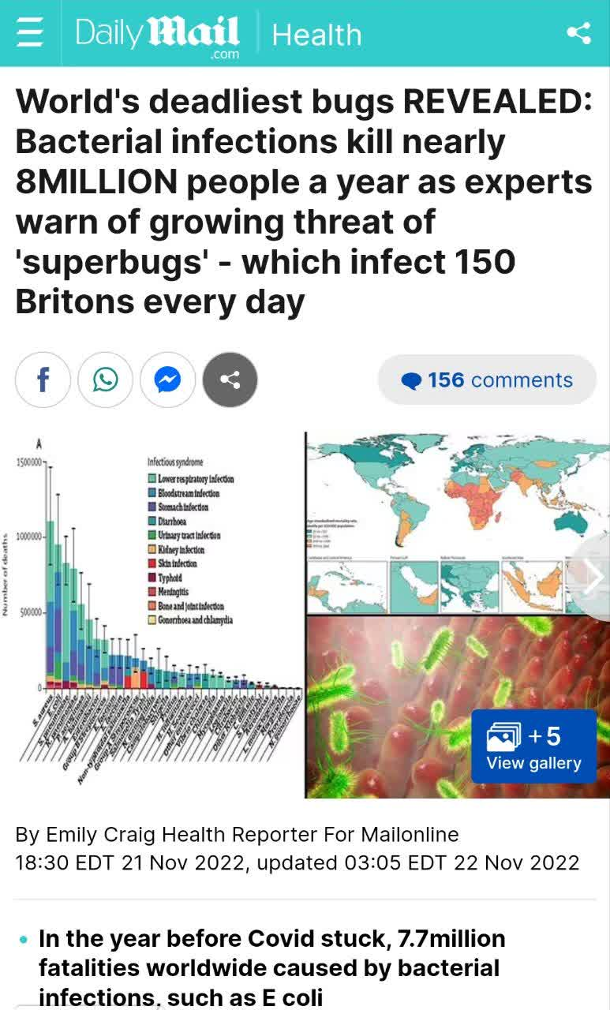
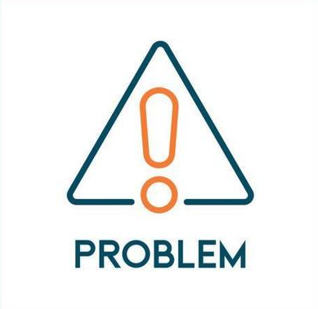
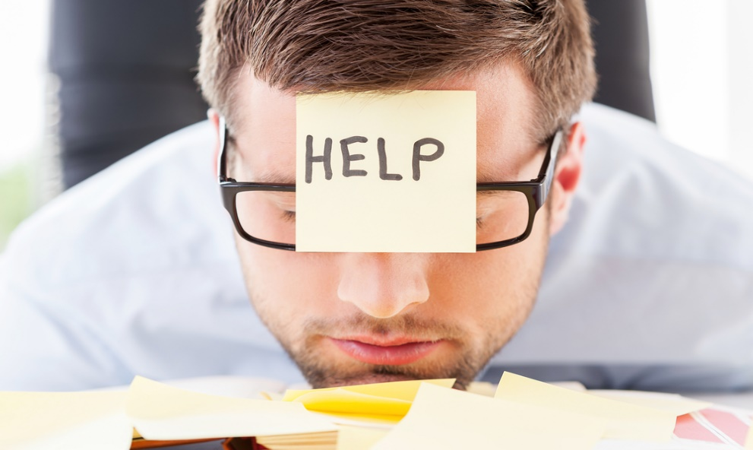


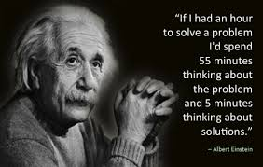

Problem: A situation, person, or thing that needs attention and needs to be dealt with or solved
Problem: A chance for you to did your best

Slide 3
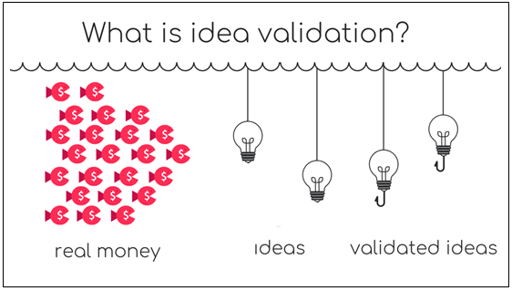
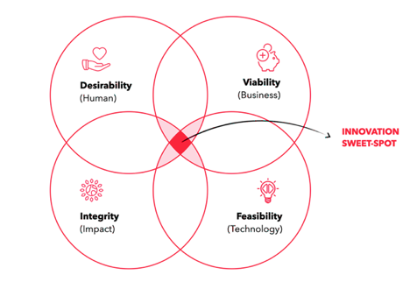
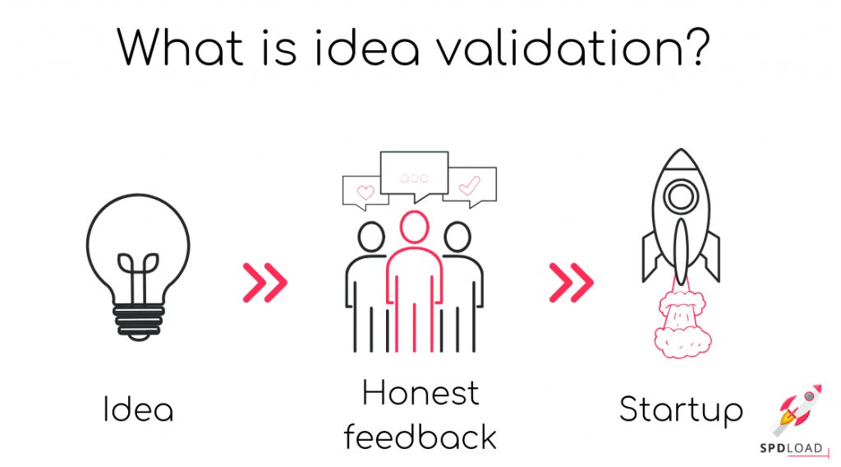
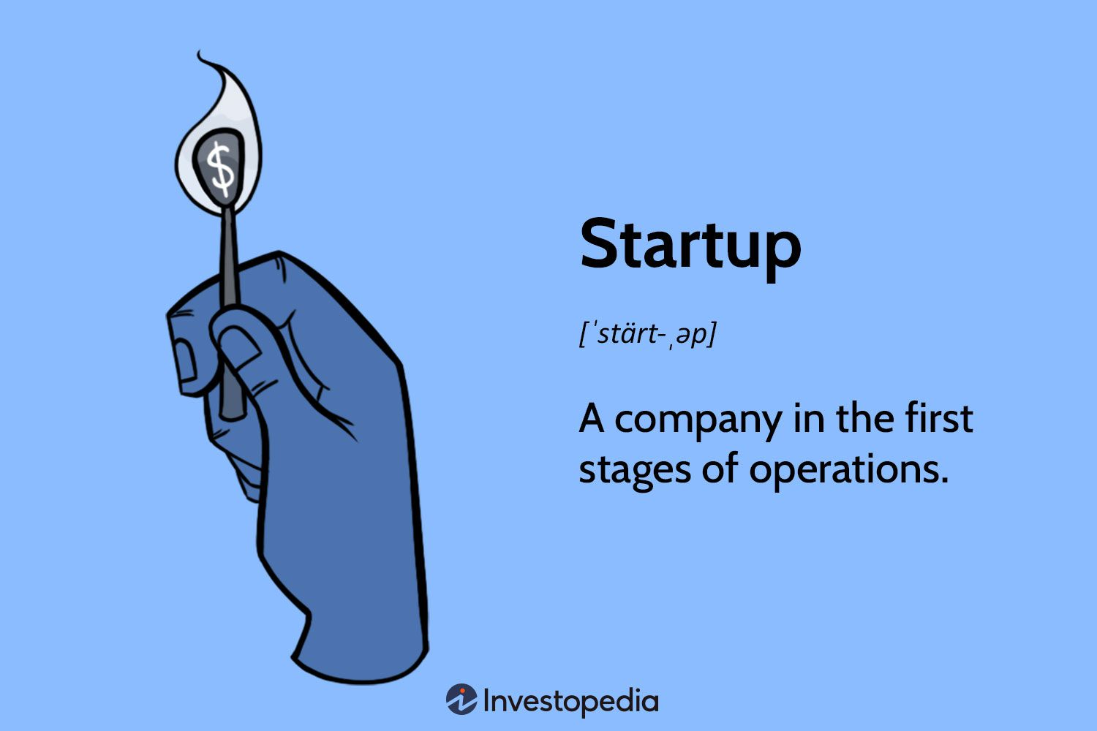
Feasibility: Can it be built?
Viability: Can you make a business out of it? Will it be sustainable and scalable?
Desirability: Do people want your product or service?
Integrity/Ethics: How does business impact society and the environment?

Slide 4
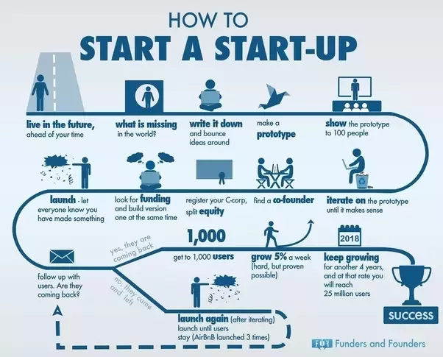

Slide 5
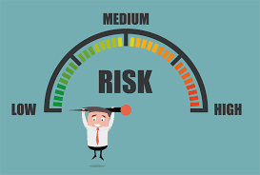
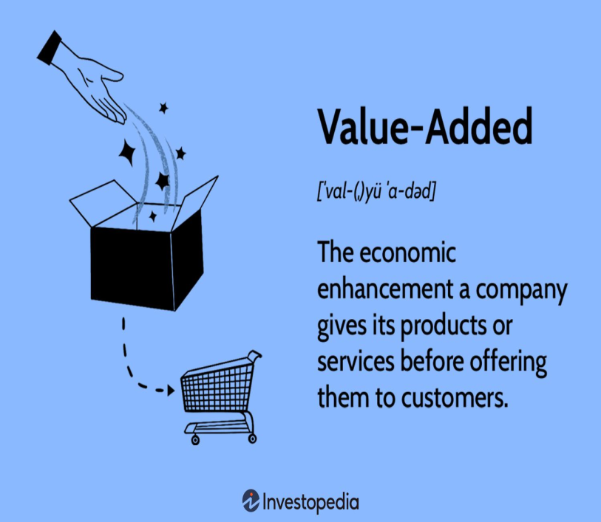
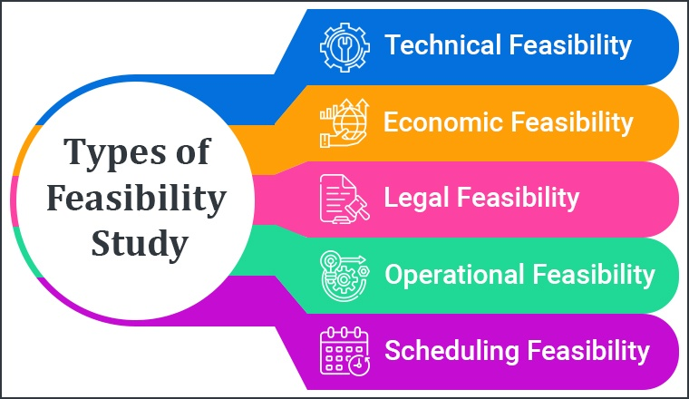
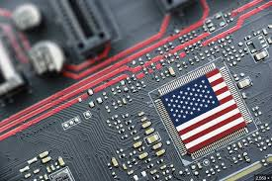
Feasibility value
Added Value
Feasibility Types
Foreign dependency

Slide 6
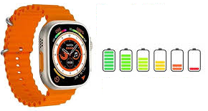
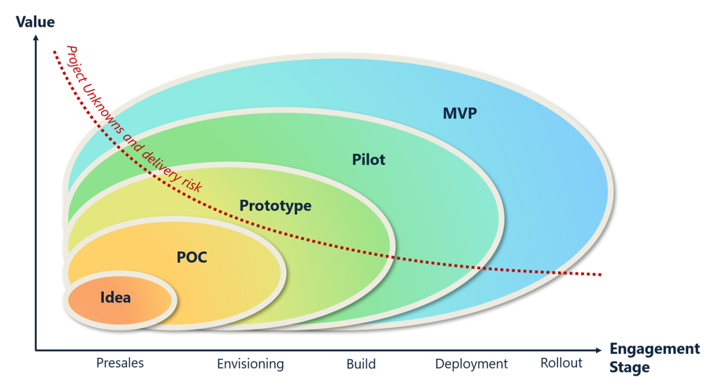
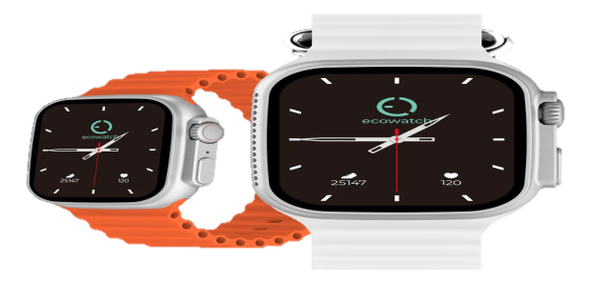
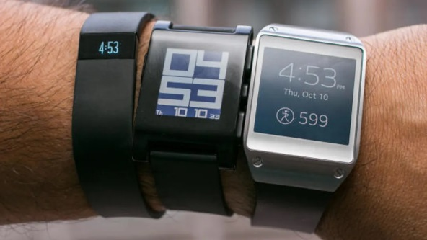
Proof of Concept (POC) - Testing the Idea
Smartwatch Battery Life Test
Prototype - Bringing the Idea to Life
Pilot - Testing in a Controlled Environment
Smartwatch Design
and Functionality
Minimum Viable Product (MVP) - The Initial Step to Market
Limited Release of Smartwatch
Market-Ready Smartwatch

Slide 7
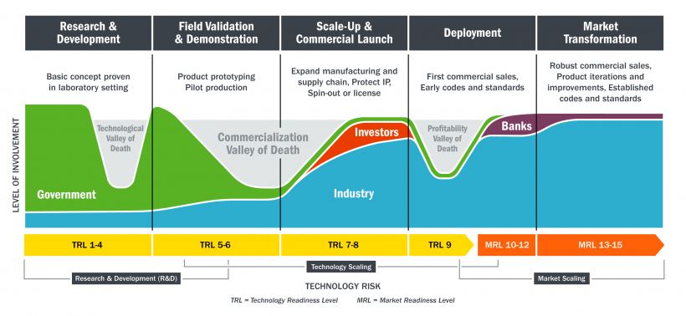

Slide 8


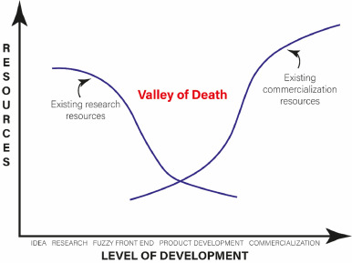
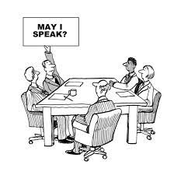

The Valley of Death (VoD) reflects a series of challenges facing technology-based companies during their early development stages.
Experienced team members
Industry expertise
Shareholder's agreement
Legal practitioner

Slide 9
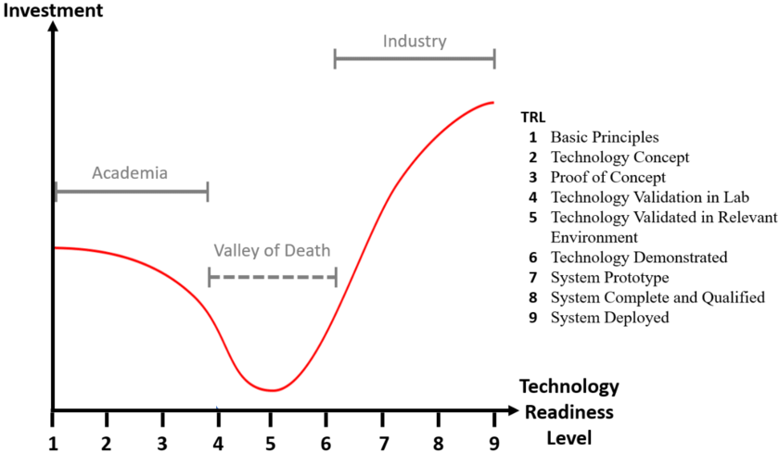

Slide 10
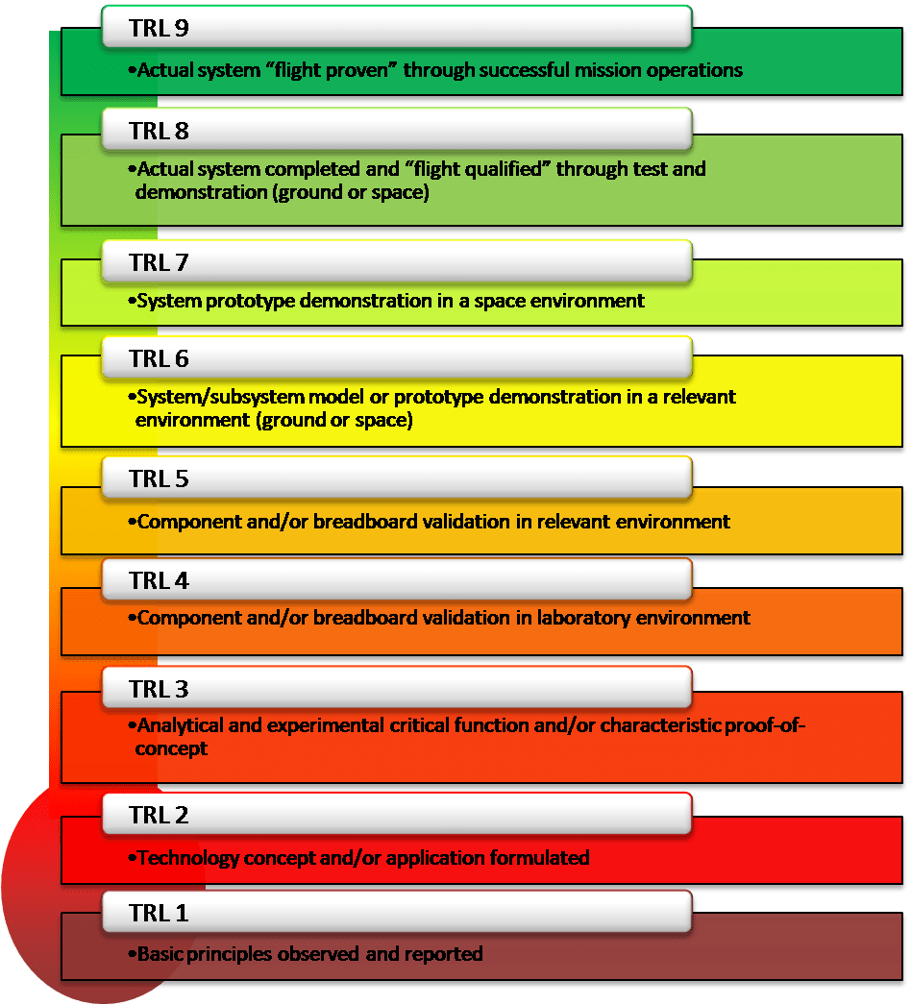



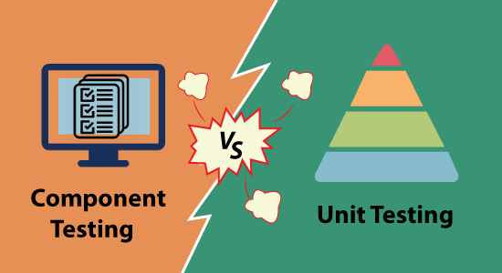

Scientific research
little to no experimental proof of concept
Analytical and laboratory studies
Component testing
Rigorous testing

Slide 11
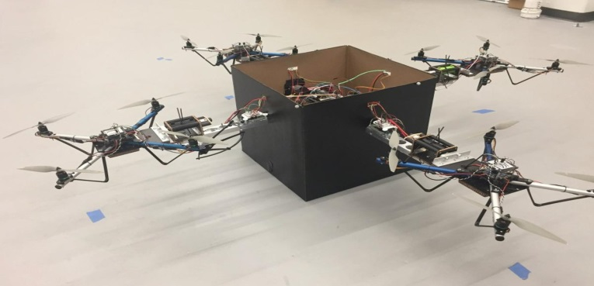
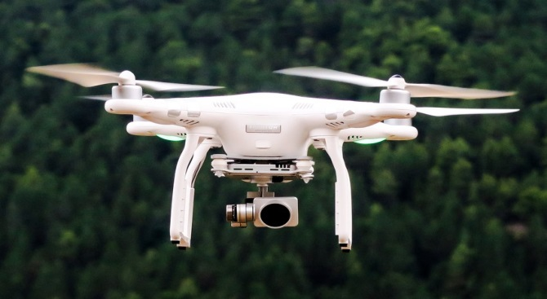
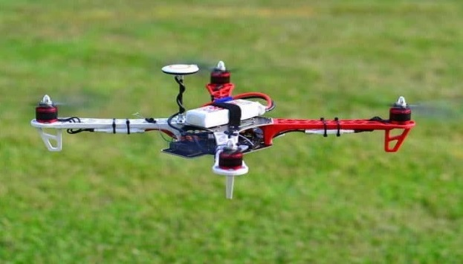
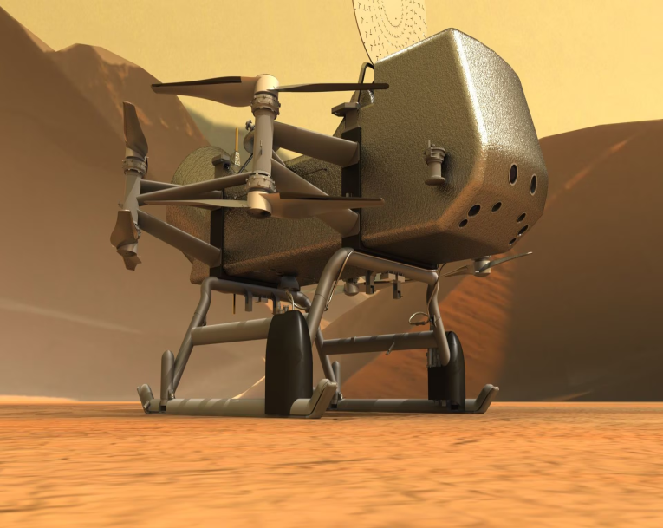
Ready for implementation into an already existing technology
Fully functional prototype
working model
Successful mission

Slide 12
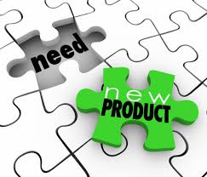
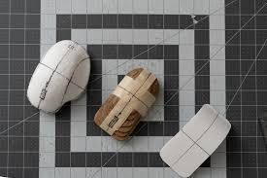
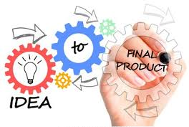
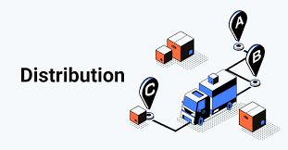

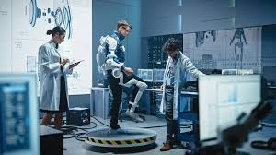
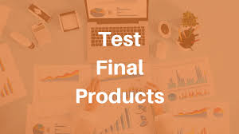
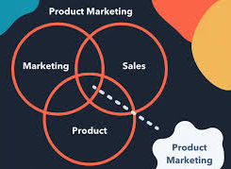
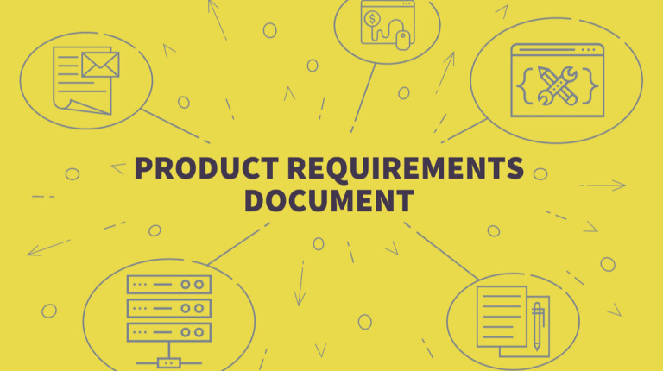
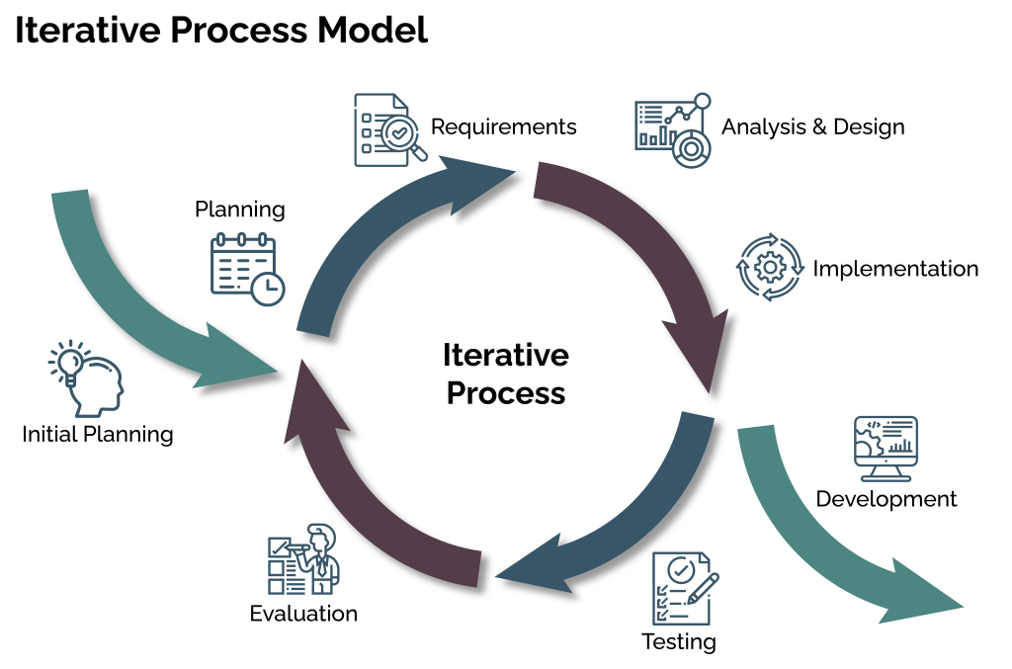


Slide 13
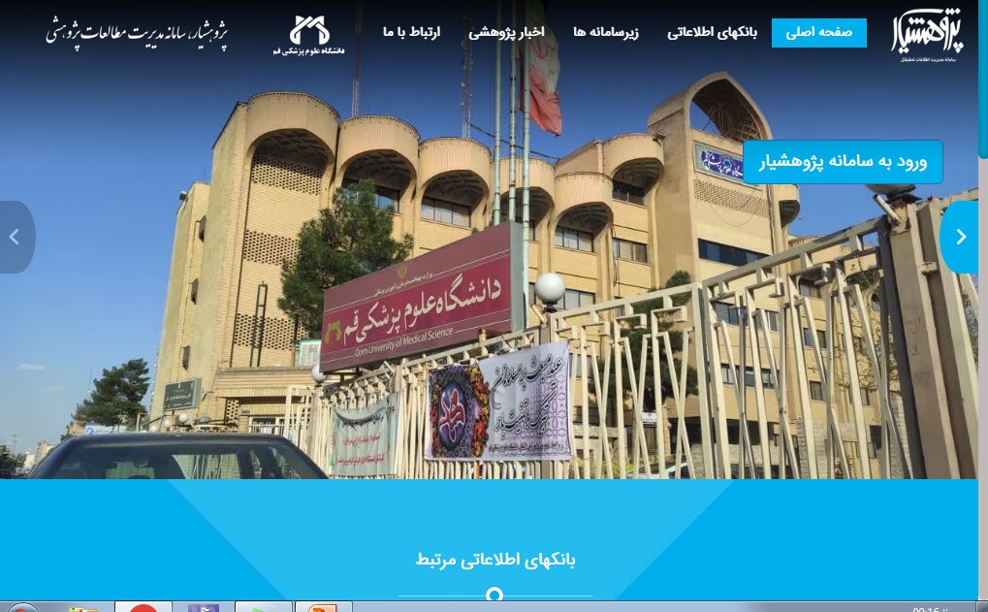
https://ris.muq.ac.ir/

Slide 14
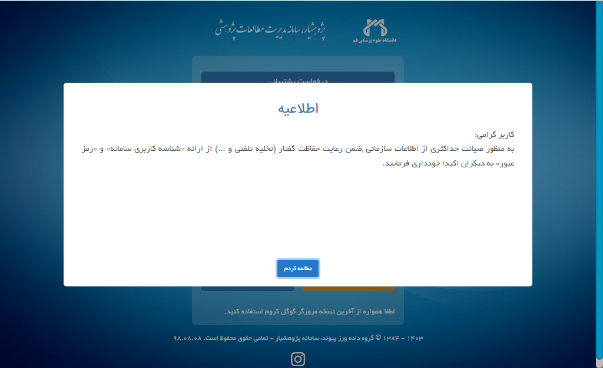

Slide 15
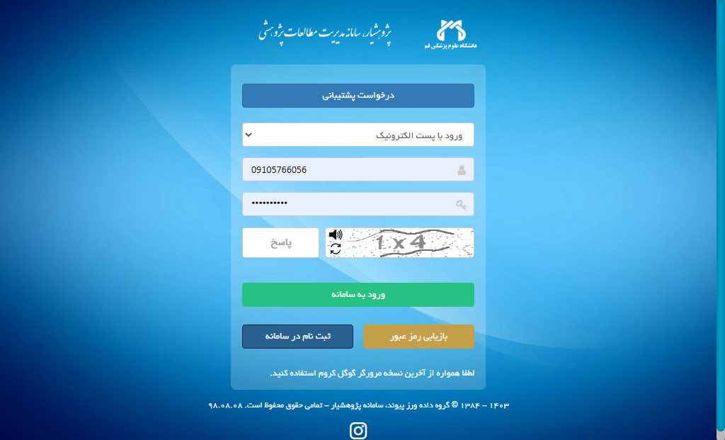
https://ris.muq.ac.ir/

Slide 16
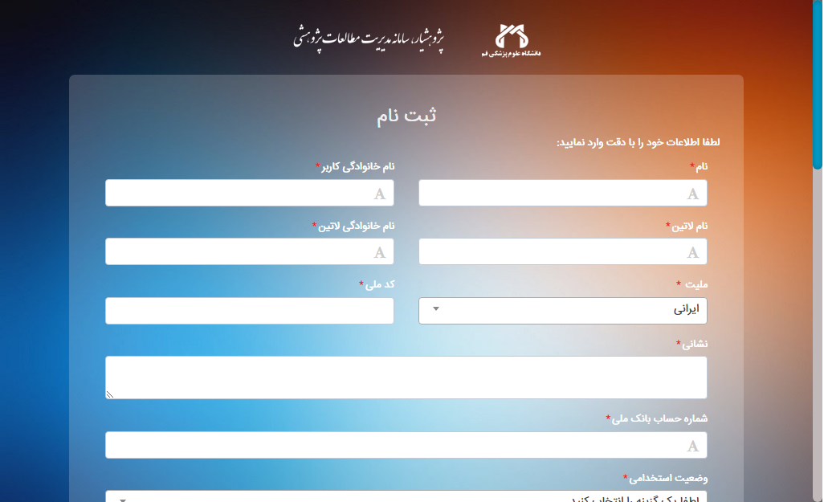

Slide 17
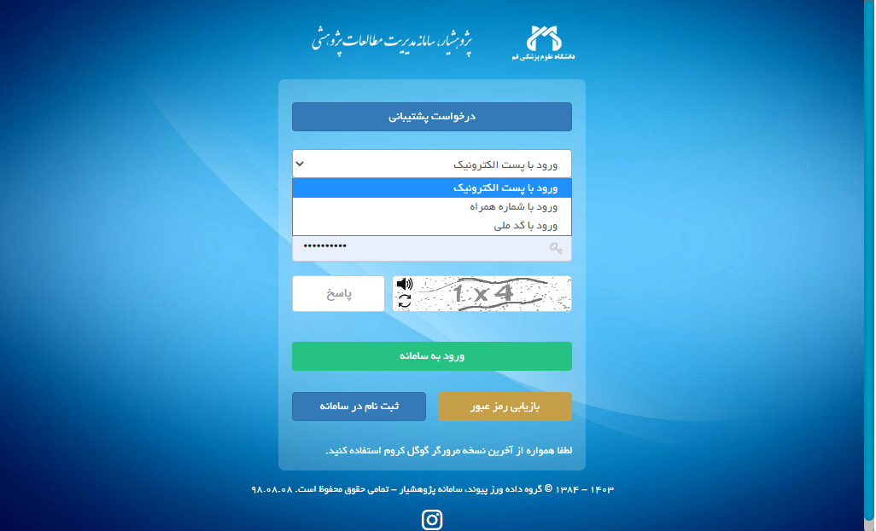

Slide 18
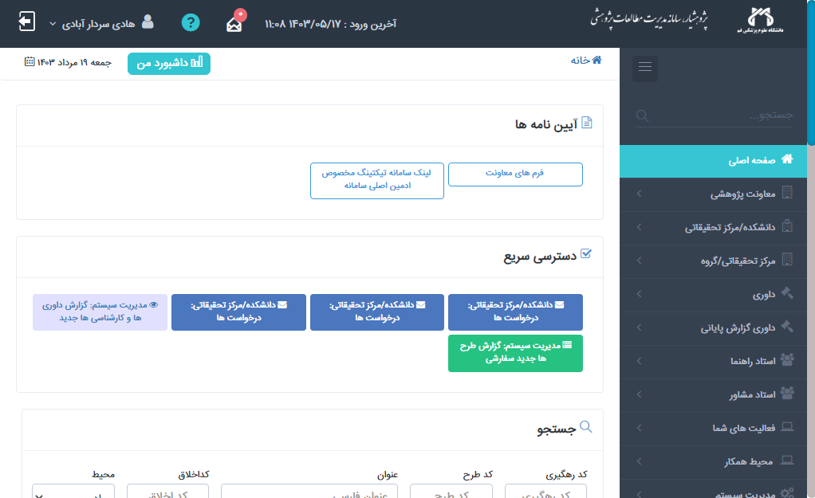

Slide 19
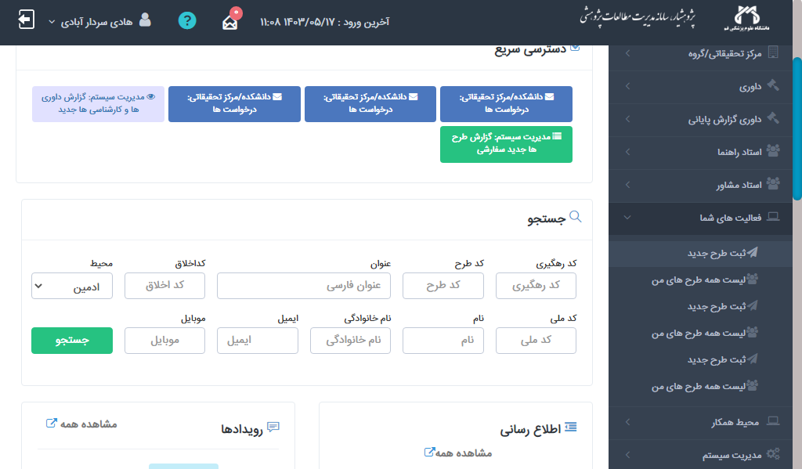

Slide 20
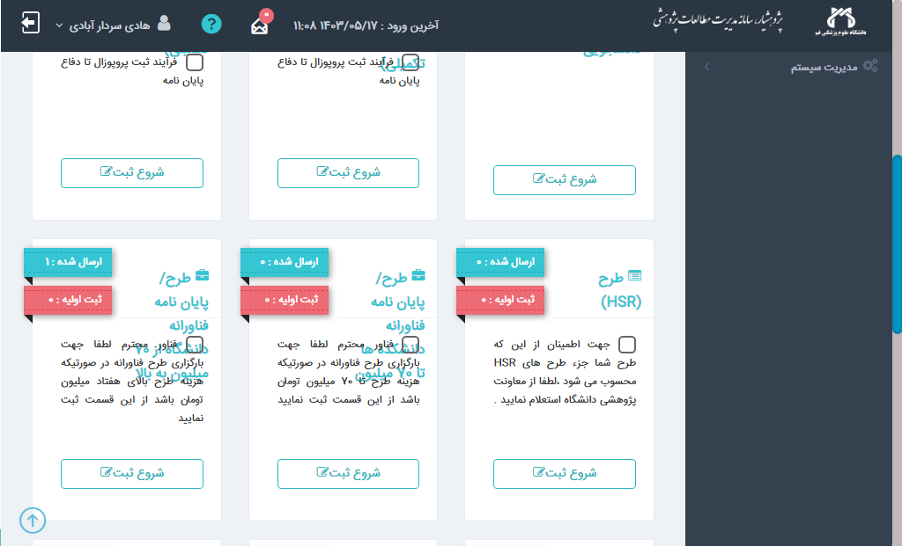

Slide 21
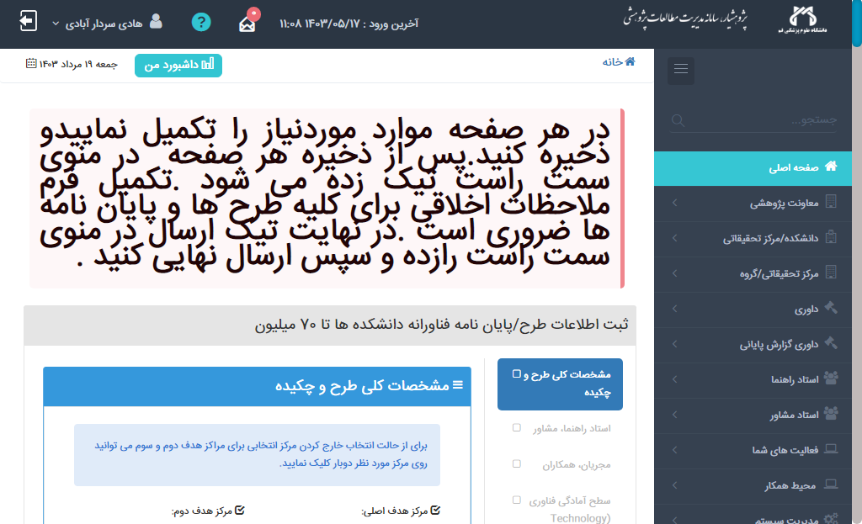

Slide 22








مدیریت توسعه فناوری سلامت
دفتر مالکیت فکری و ثبت اختراع
ارتباط با صنعت و جامعه
مرکز کارآزمایی بالینی
مرکز رشد و نوآوری سلامت
1401
1402
1403
1401
1402
1403
1401
1402
1403
1401
1402
1403

Slide 23

متشکرم

